Slide 1
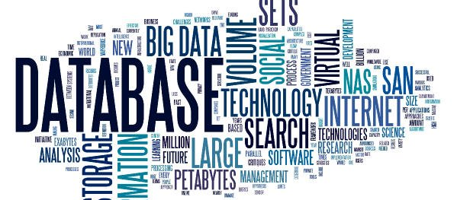
Relational Database Management
Presented by : Nassir hanane

Slide 2
Summary
What is a database?
Why are databases important?

Slide 3
What is a database
Databases play a crucial role in managing, organizing data by providing a structured way to store, retrieve, and manage large amounts of data efficiently, ensuring data integrity and security.
Their significance can be summarized in several key areas:
Data Organization and Retrieval
Data Integrity and Security
Scalability and Performance
Decision Making and Reporting
A common example of database use is in e-commerce, where relational databases track customer data, orders, and inventory.
Notes:
Databases are important because they provide a structured way to store, retrieve, and manage large amounts of data efficiently, ensuring data integrity and security.
They enable organizations to analyze data effectively, leading to informed decision-making and improved operational efficiency
In summary, databases are essential for effective data management, and analysis, making them foundational to modern business operations and decision-making processes.

Slide 4
Why are databases important
In today's data-driven society, the databases form the backbone of many modern applications, organizational processes, and decision-making strategies.
To understand deeper the role and insights we have some key benefits :
Data Organization and Retrieval
Databases provide a structured way to store data, making it easier to organize, search, and retrieve information.
Data Integrity and Security
Databases enforce rules that ensure data accuracy and consistency, which is essential for informed decision-making.
Scalability and Performance
Databases can efficiently handle large volumes of data and user requests, ensuring that performance remains high as data grows.
Techniques like indexing and caching improve data retrieval speed, enhancing overall system performance.

Slide 5
references
https://www.geeksforgeeks.org/dbms/what-is-database/
https://optimizdba.com/the-importance-of-databases-in-todays-digital-world/
https://whatisdatabase.com/understanding-databases-importance-and-benefits-explained

